Slide 1
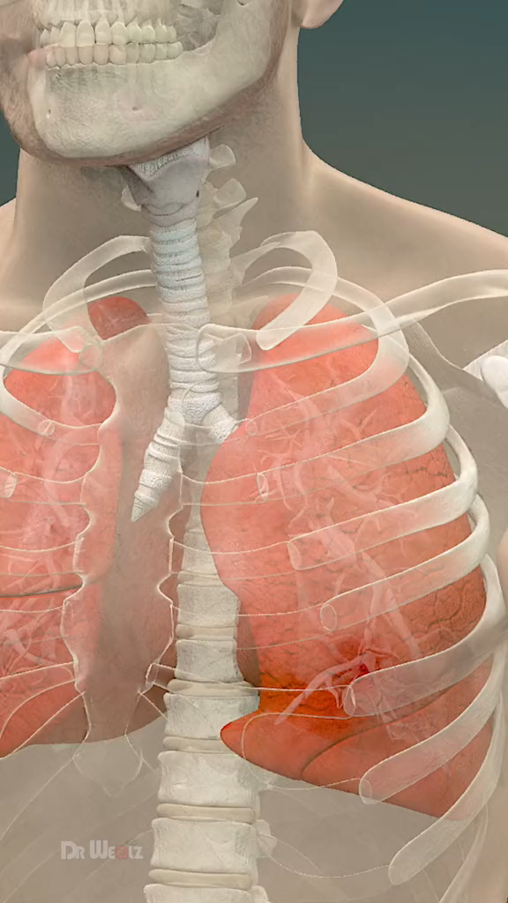
AUTOMATED PNEUMONIA DETECTION FROM CHEST X-RAY IMAGES

Slide 2


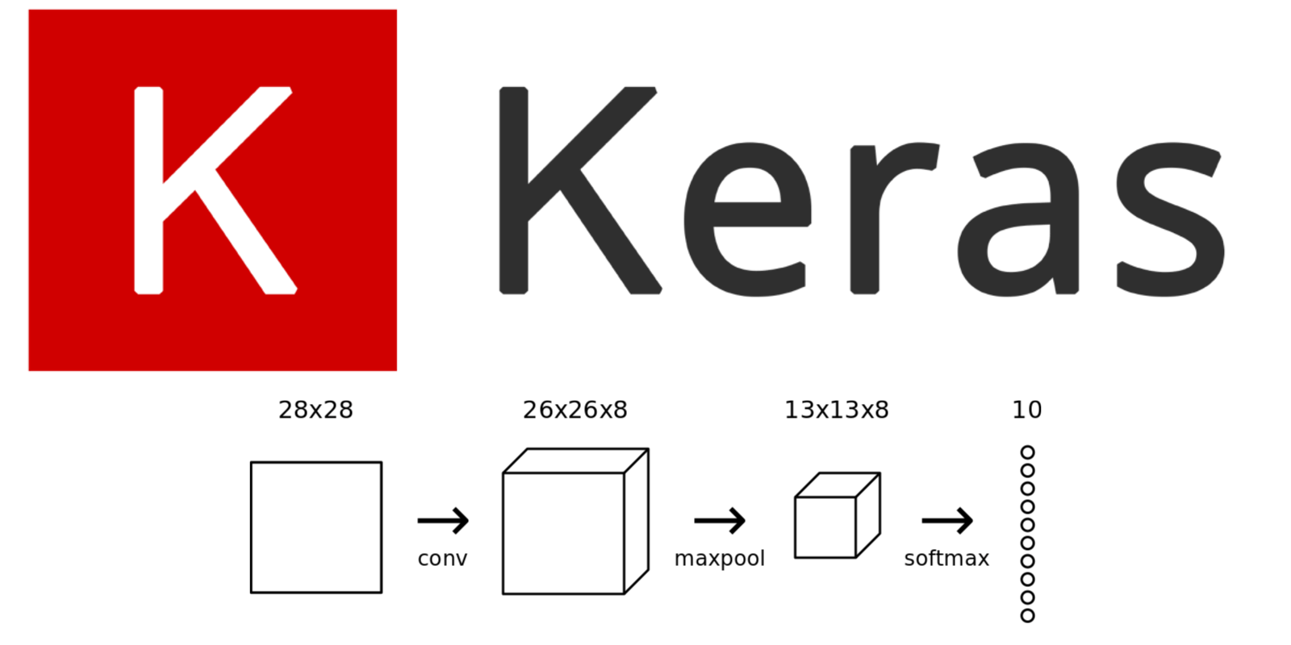
DATASET
Kermany, Daniel; Zhang, Kang; Goldbaum, Michael (2018), “Labeled Optical Coherence
Tomography (OCT) and Chest X-Ray Images for Classification”, Mendeley Data, V2, doi:
10.17632/rscbjbr9sj.2
MODULES USED
Keras
Numpy
Pandas
Matplotlib
Seaborn
Sklearn

Slide 3
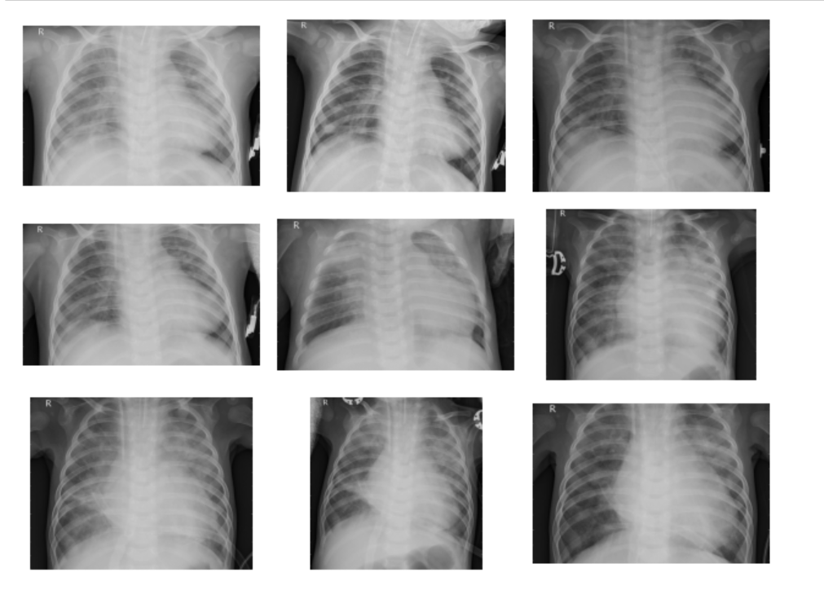
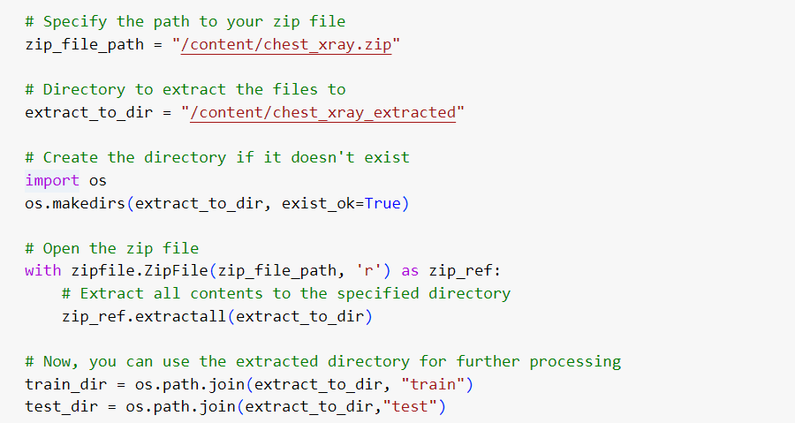
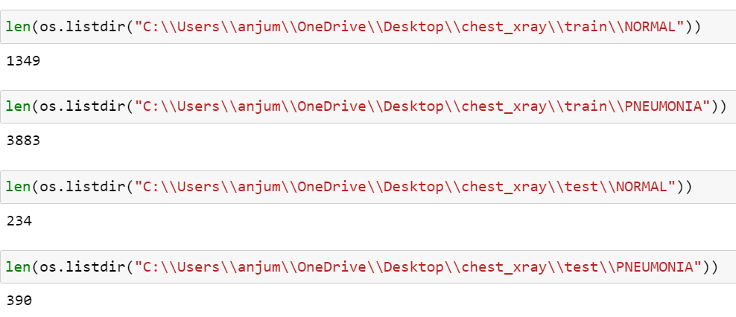
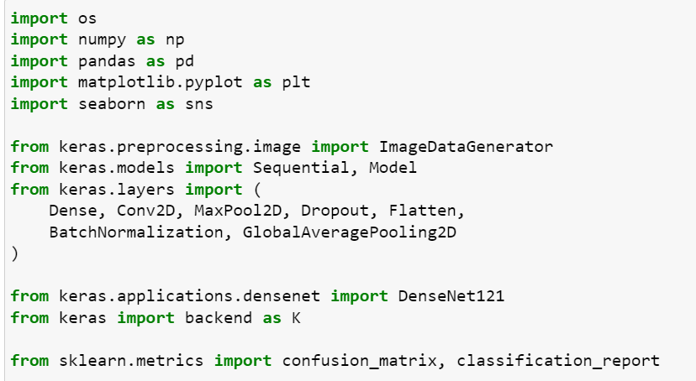
Importing Libraries
Data loading
Dataset Exploration
Data Visualization

Slide 4
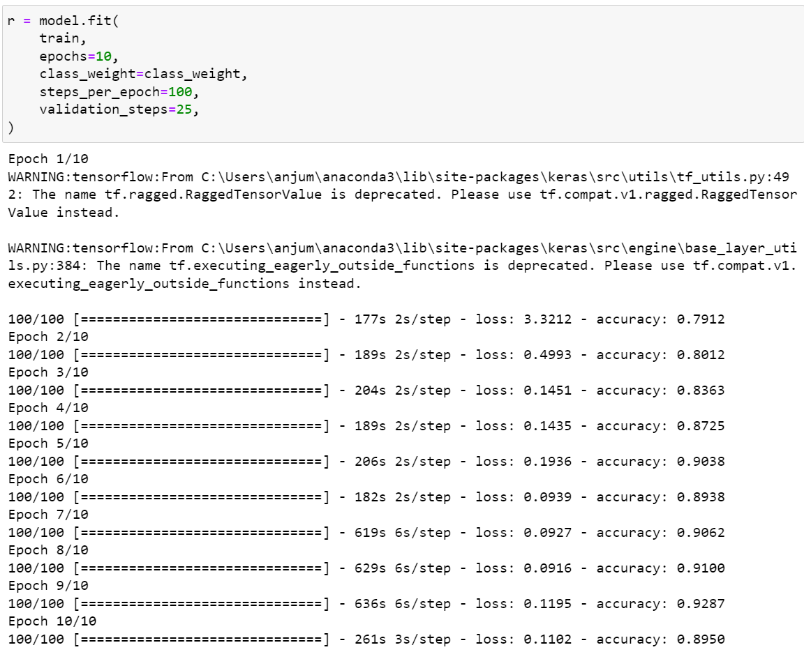
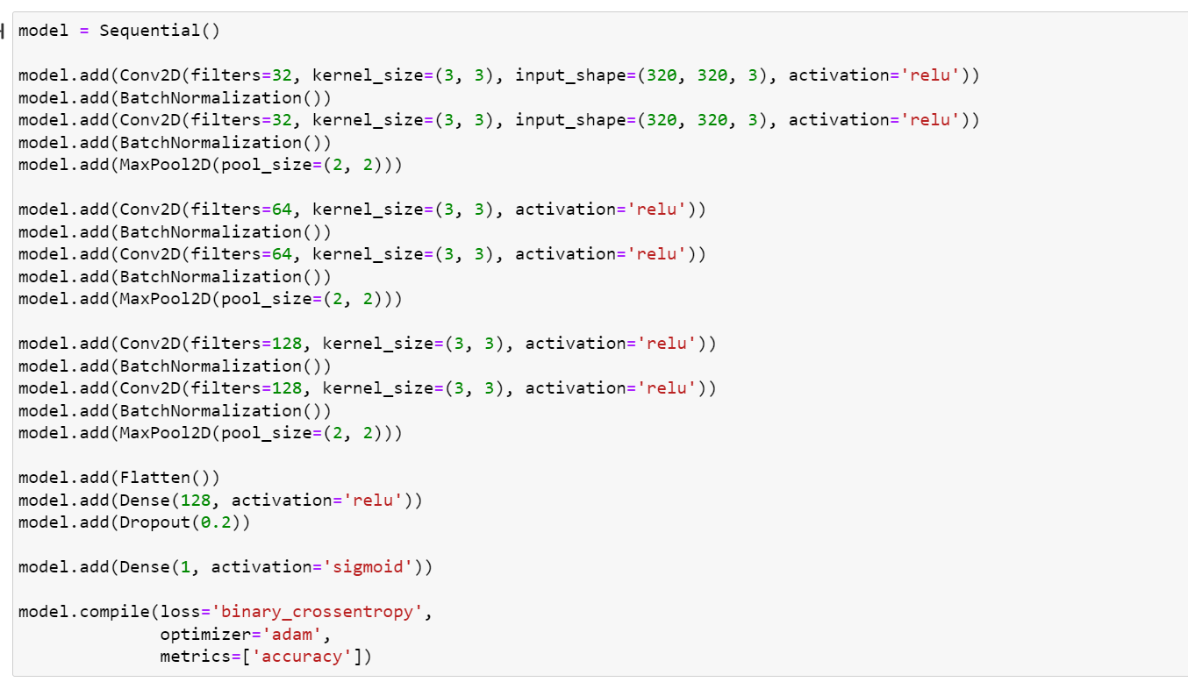
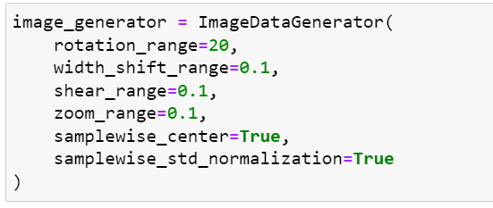
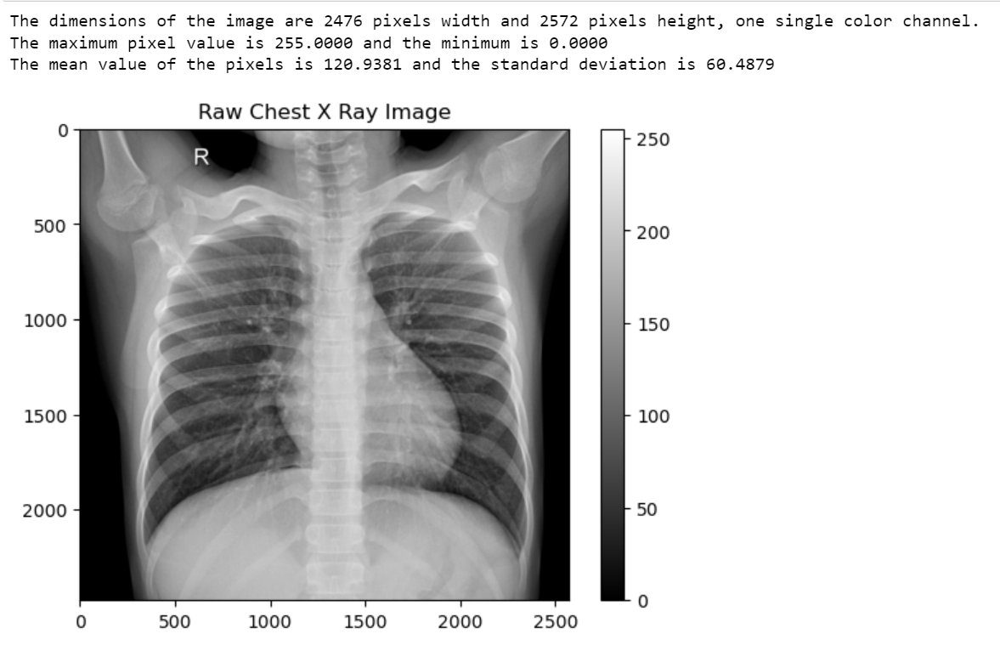
Image Analysis
Data Augmentation
Model Definition
Model Compilation

Slide 5
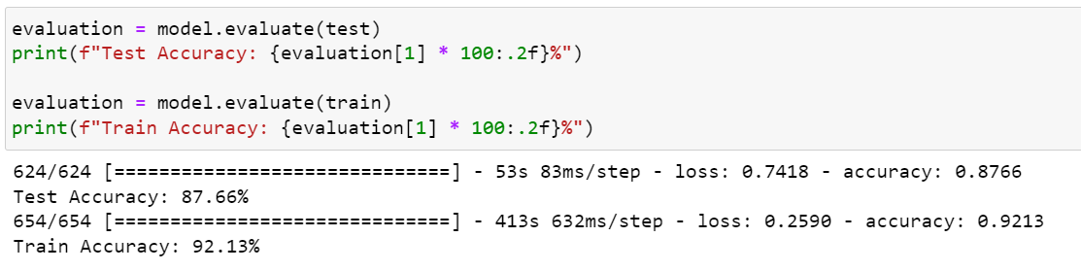
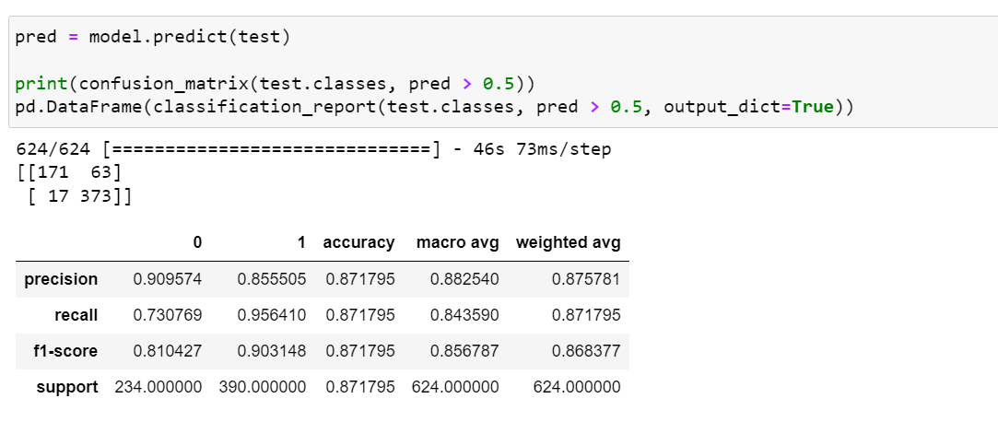
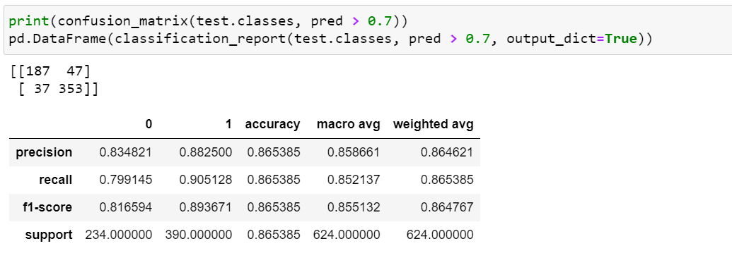
Model Training
Model Evaluation
Model Prediction
Results Visualization

Slide 6

Model Architecture
conv2d
Batch
norm
conv2d
Batch
norm
Max pool
conv2d
Batch
norm
conv2d
Batch
norm
Max pool
conv2d
Batch
norm
conv2d
Batch
norm
Max pool
flattten
dense
Drop
out

Slide 7

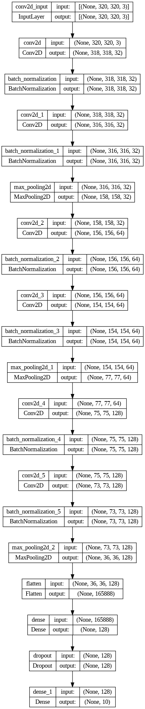

Slide 8

Strength
Deep Learning Architecture
Weakness
Limited Model Optimization
Opportunities
Hyperparameter Tuning
Threats
Overfitting
Data Exploration
Transfer Learning
Data Quality
Computational Resources
Ethical Concerns
Data Augmentation
Class Weight Handling
Model Evaluation
SWOT
ANALYSIS

Slide 9
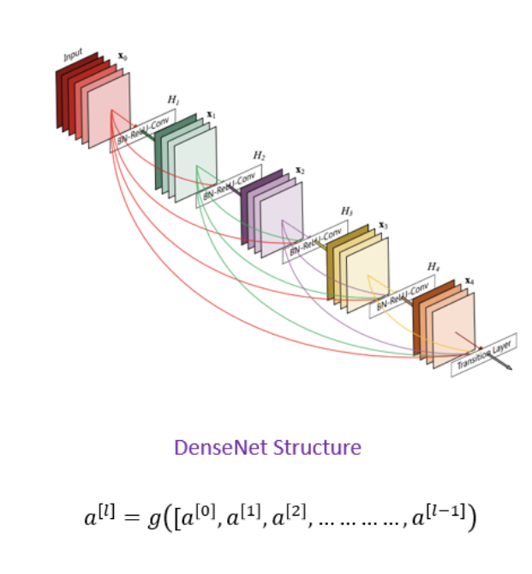
Future Work Plan
To mitigate overfitting in chest X-ray classification, we can employ DenseNet, a powerful pre-trained deep learning architecture. By leveraging its learned features and freezing its layers, we prevent the model from overfitting to our limited dataset. We add additional layers like dropout and dense layers to enhance the model's generalization ability. These layers help regularize the model and make it more robust to unseen data. By training the modified model and evaluating its performance, we aim to achieve accurate and reliable chest X-ray classification results while mitigating overfitting issues.

Slide 10

THANK YOU
Susmitha Bommini
Anjum Shaik

